Slide 1
SAP Business One
Software Development Kit Training
August 2004
Course Project

Slide 2
Video Library Module Description
Within the Course Project we will create an add-on using the UI and the DI API while focusing on version 6.7 features.
This add-on will add a small module that will enhance SAP Business One application functionality.
This module is a Video Library Management tool.
The video library has 10 shelves and on each shelf there is space for 100 video movies.
The library management tool handles the following functionalities:
  Add New movie.
  Find movie location.
  Displays movies on Shelf list.
  Rent a Movie.

Slide 3
SDK – Course Project
Contents:
  Unit 1 – Infrastructure, Adding MetaData Objects.
  Unit 2 – Screen Painter.
  Unit 3 – Creating Video Library Management Add-0n.
  Unit 4 – Add-On Administrator.
  Unit 5 – License.
  Unit 6 – UDO: User Defined Object.

Slide 4
Unit 1: Infrastructure, Adding MetaData – Unit Objectives
Unit 1
By the end of this unit, you will:
Know how to add UserTable and UserFields to the company DB.
Add the required MetaData for the Video Library Management tool.

Slide 5
Unit 1: Agenda
Unit 1
Adding MetaData Objects
  Add UserTable
  Add UserFields to UserTable
  Insert Data Into UserTable
Notes:
Please use the DI exercise you’ve done in the DI introduction Unit.

Slide 6
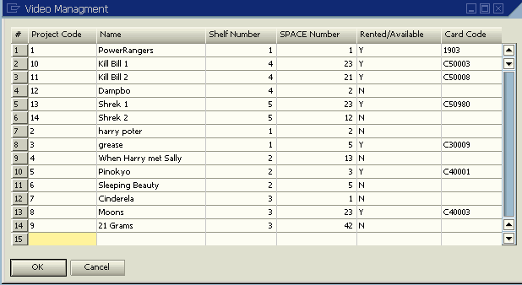
Adding MetaData Objects
Unit 1
In order to manage the Video Library, The following table should be added to the Company DB, The table will have the following structure:
Notes:
This is the VIDS table you should create and add into your company DB.
The UserTable is created with 2 default fields: ProjectCode & Name. We will use the project Code for holding a Unique Code for each movie saved in the DB and the Name for holding the Movie Name.

Slide 7
1.Add UserTable - Code
Unit 1
Dim oUserTablesMD As SAPbobsCOM.UserTablesMD
' Init the MetaData object
oUserTablesMD = oCompany.GetBusinessObject(SAPbobsCOM.BoObjectTypes.oUserTables)
' set the 2 mandatory fields
oUserTablesMD.TableName = "VIDS"
oUserTablesMD.TableDescription = "Video Managment"
lRetCode = oUserTablesMD.Add
'// check for errors in the process
If lRetCode <> 0 Then
oCompany.GetLastError(lErrCode, sErrMsg)
MsgBox(sErrMsg)
Else
MsgBox("Table: " & oUserTablesMD.TableName & " was added successfully")
End If

Slide 8
2. Add User Field To User Table - Code
Unit 1
Dim oUserFieldsMD As SAPbobsCOM.UserFieldsMD
oUserFieldsMD = oCompany.GetBusinessObject(SAPbobsCOM.BoObjectTypes.oUserFields)
' Adding the "SHELF" field, Setting the Field's mandatory properties
oUserFieldsMD.TableName = "@VIDS
oUserFieldsMD.Name = "SHELF"
oUserFieldsMD.Description = "Shelf Number"
oUserFieldsMD.Type = SAPbobsCOM.BoFieldTypes.db_Numeric
oUserFieldsMD.EditSize = 2
' Adding the Field to the Table
lRetCode = oUserFieldsMD.Add
' Check for errors
If lRetCode <> 0 Then
oCompany.GetLastError(lErrCode, sErrMsg)
MsgBox(sErrMsg)
Else
MsgBox("Field: '" & oUserFieldsMD.Name & "' was added successfuly to " & oUserFieldsMD.TableName & " Table")
End If
Notes:
Use the following sample for adding all the needed UserFields to the UserTable.

Slide 9
3. Insert Data Into UserTable.
Unit 1
Dim oUserTable As SAPbobsCOM.UserTable
'// set the object with the requested table
oUserTable = oCompany.UserTables.Item("VIDS")
'// set the two default fields
oUserTable.Code = 15
oUserTable.Name = "Speed 1"
'// set the user fields
'Shelf Number
oUserTable.UserFields.Fields.Item("U_SHELF").Value = 5
'Space Number
oUserTable.UserFields.Fields.Item("U_SPACE").Value = 2
'Rented
oUserTable.UserFields.Fields.Item("U_RENTED").Value = "Y"
'CardCode
oUserTable.UserFields.Fields.Item("U_CARDCODE").Value = "C50003"
'// add the data to the Data base
oUserTable.Add()
Notes:
Adding records to the DB using the DI API is useful while coping information from one table to another.
You can insert data records to your user table by using SAP Business One interface, Just choose: Tools → User Tables → Choose your table. Your table will be opened for your convenient.

Slide 10
Unit 1: Summary
Unit 1
After finishing this unit:
You have all the required infrastructure for managing the video Library.
You know how add MetaData objects and how to fill your UserTable with Records.

Slide 11
Unit 2: Screen Painter
Unit 2
By the end of this unit, you will:
Become Familiar with the Screen Painter

Slide 12
Unit 2 – Screen Painter Agenda
Unit 2
What is the Screen Painter?
Features
Property Editor
  Items List
  Forms
  Items
  Columns
Form Design
Tool Box
  Create New Form
  Adding and aligning form items
  Loading and saving forms
  Exiting screen painter

Slide 13
1. What is the Screen Painter?
Unit 2
The screen painter is A graphical tool that provides the possibility to create user forms with SAP Business One look and feel quickly and easily.
The Screen Painter is an Add-on. After being installed, It is loaded automatically by SAP Business One application.
The Screen Painter environment consists of three screens:
  Tool Box window
  Property Editor window
  New Form window
Notes:
B. After installing the screen painter, it will be automatically loaded whenever you’ll load SAP Business One application (like any other registered UI Add-on).
You will see new menu entry in the command Center: „Development Tools“.
In order to load the screen painter, choose the following menus: Development Tools → Screen Painter
After entering to the Screen Painter, the entry SAP Business One in the Main Menu, is replaced with a new entry, Form Design.
C. Screen Painter Environment description:
Tool Box – contains form items, alignment, and filling commands.
Property Editor – allows you to set and examine the properties of forms and form items and lists the item types that you add to your new form.
New Form – the template you use to design a new form.

Slide 14
2. Screen Painter Features
Unit 2
Supports all form item types used within the UI-API
Add Items to form by using simple Drag & Drop
Easy allocating and resizing of form items
Easy access to form and items properties.
Simple alignment functionality
Notes:
Please Notice: Having created and stored your new form in SAP Business One Resource File format (.srf), you must manually include it in your Add-on development project.
The alignment functionality is available to other items or to design grid.

Slide 15
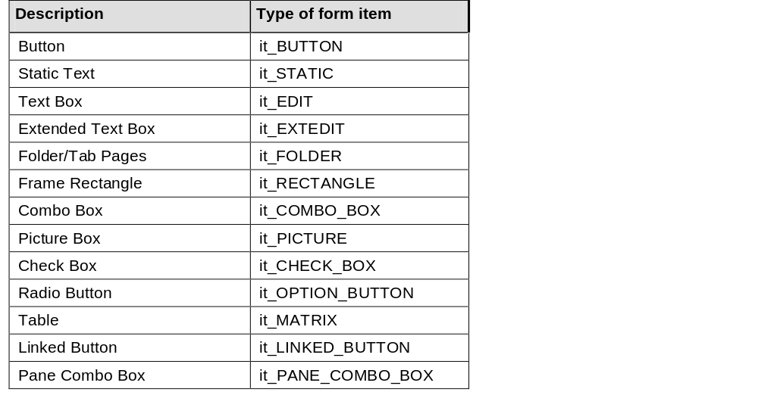
3.A Property Editor – Items List
Unit 2
Notes:
You can add to your form any one of the items.
In the Property Editor, choose Items List. You can view items and use drag and drop to change their order within your form.

Slide 16
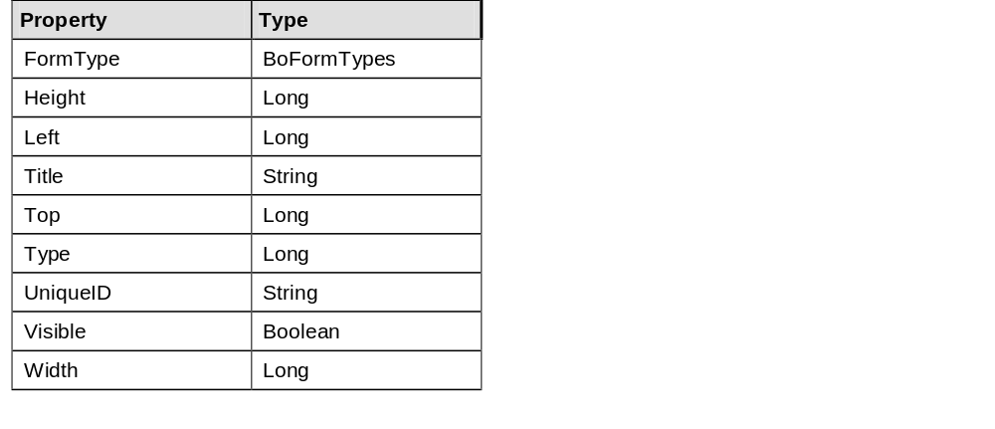
3.B Property Editor – Form properties
Unit 2
Notes:
You can set and change form properties according to your requirements.

Slide 17
3.C1 Property Editor – Item properties
Unit 2
Use the properties window for changing and setting items properties
There are two types of item properties:
  General properties - identical for all form item types
  Specific properties – are relevant properties for the specific item type
General Properties:
Top
Left
Height
Width…
Specific Properties:
BackColor
FontSize
ForeColor
String
TextStyle…
Notes:
When you add an items to your form, its properties are displayed in the Property Editor (in the left side of the screen).
Specific properties: The Property Editor adds specific properties to the properties list according to the item type you select.
General Properties sample: Width, height, length, top, etc.
Specific Properties sample: ComboBox valid values, Button caption, etc.

Slide 18
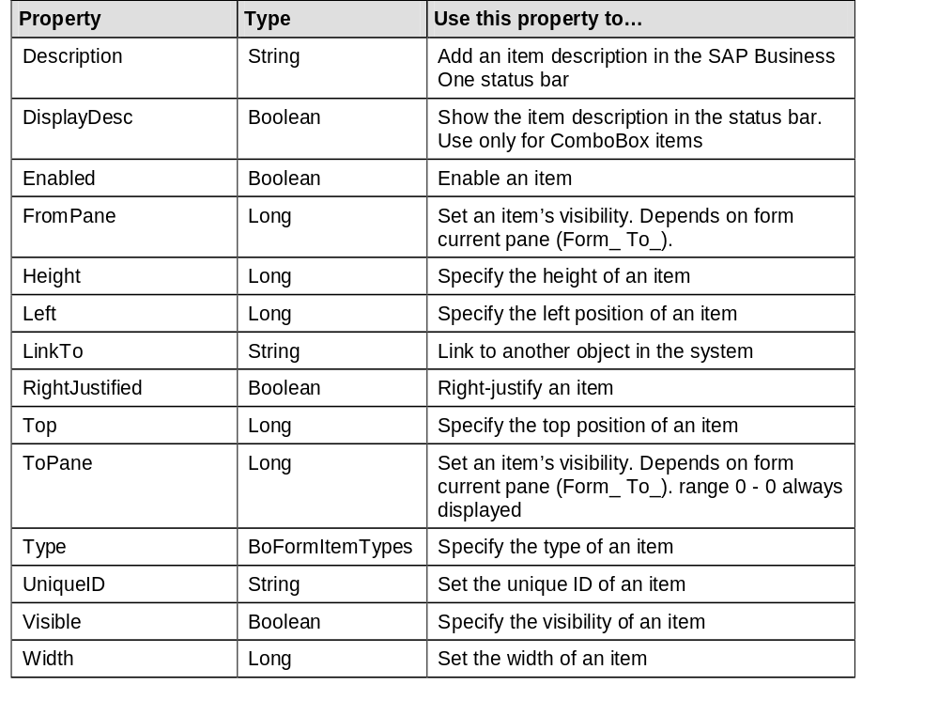
3.C2 Property Editor – General Item properties
Unit 2

Slide 19
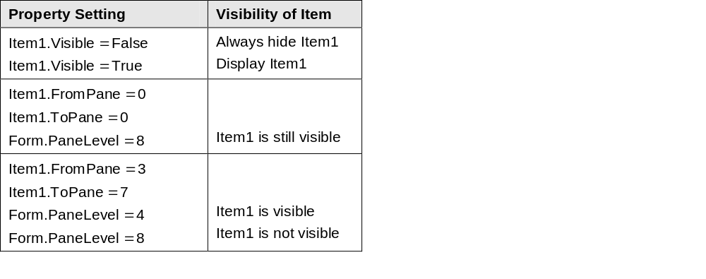
3.C3 Property Editor – General Item properties - continue
Unit 2
Item Visibility:
The form property “PaneLevel” controls item visibility.
Visible property:
TRUE
  item visibility is controlled by the FromPane and ToPane item properties and form PaneLevel Property.
FALSE
  Items are always invisible
Notes:
Items will be visible only if the current form PaneLevel is between it’s FromPane – ToPane range definition.
Items with values of FromPane = 0, and ToPane = 0, are not controlled by PaneLevel and are always displayed.

Slide 20
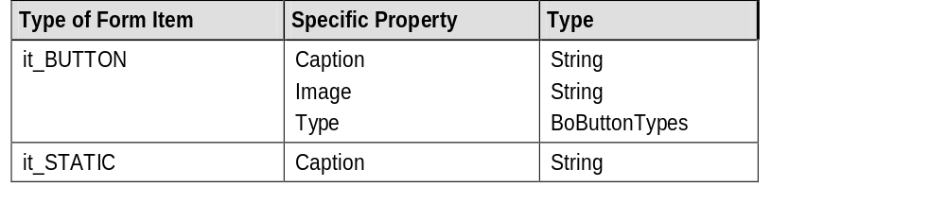
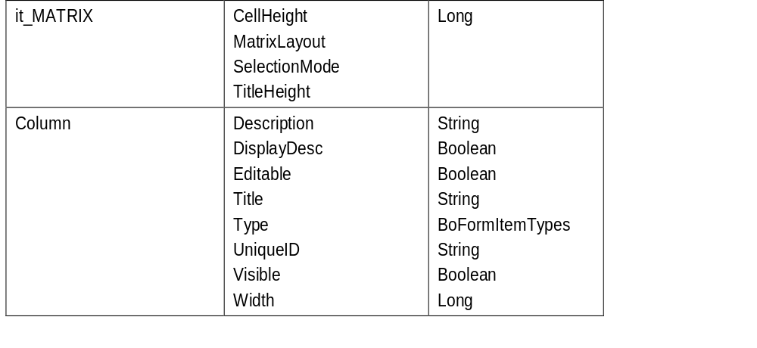
3.C4 Property Editor – Specific Item properties
Unit 2
…
.
.
.
Notes:
For each Item type there are different specific properties.
Please refer to the full list in the Screen Painter documentation.

Slide 21
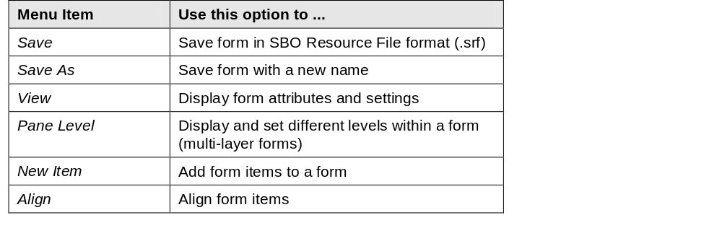
4. Form Design – Menu Options
Unit 2
View sub menu:
  Hidden Items
  Items Rectangles
  Grid
  Settings:
    Grid Size
    Frame Size
    Grid Color
    Form Color
Notes:
Vide Hidden Items → Displays all the form items (visible and hidden)

Slide 22
5. Tool Box
Unit 2
The Tool Box provide a quick access (using icons) to the functions and commands mostly used during the design process.
For example:
  Creating a new form
  Adding and aligning form items
  Loading and saving forms
  Exiting Screen Painter

Slide 23
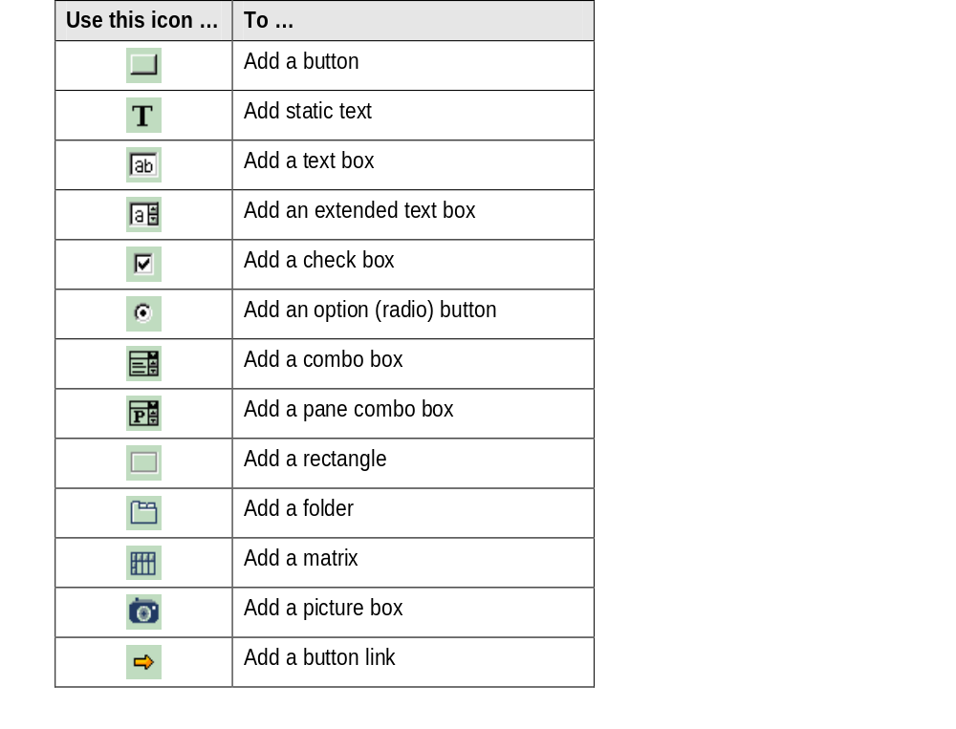
5. Tool Box – Items
Unit 2

Slide 24
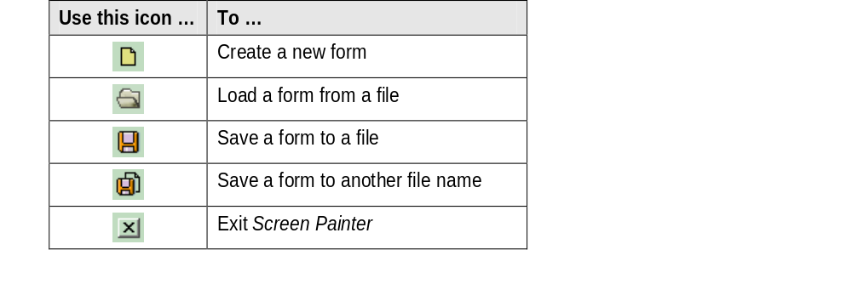
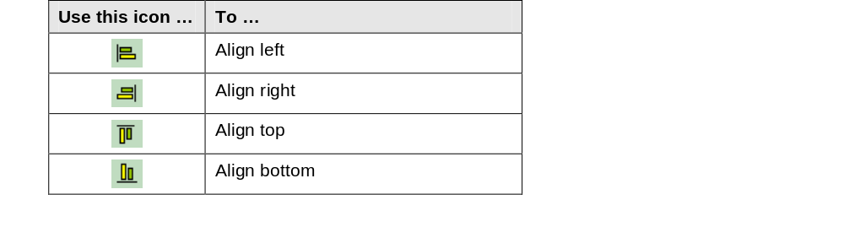
5. Tool Box – Items continue
Unit 2

Slide 25
Unit 2: Summary
Unit 2
After finishing this unit:
You are familiar with the screen painter tool.
You know how use the screen Painter.
Notes:
We will practice the screen painter in the next training unit.

Slide 26
Unit 3: Creating Video Library Management Add-0n – Unit Objective
Unit 3
By the end of this unit, you will:
Add new functionality to SAP Business One Application.
Know how to create SDK DI & UI API Add-On.

Slide 27
Unit 3: Agenda
Unit 3
Create new Add-On project
Single Sign On
Add Menu Items
Catch Menu Click Event
Add User Form
  Add User Forms Through Code.
    Draw Items on UserForm.
  Load Form From XML File
    How to create XML file from code – Code Sample.
    How to load form from XML file – Code Sample.
DataSources
  Add DataSources to Form
  Bind Items to DataSources
  Load Data to form items from DataSource
  Load Data to Matrix From DBDataSource

Slide 28
1. Create a new Add-On Project
Unit 3
In order to be able to use the SDK components you should
add the COM objects to your project references.
DI API Reference – “SAP Business One DI API Version 2004”
UI API Reference – “SAP Business One UI API Version 2004”
Now You are able to answer Unit 3 Section 1 in the Course Project exercise.
Notes:
Adding the COM objects to the project references is relevant for Visual Basic development environment.
You should refer to the COM objects according to your development environment.

Slide 29
2a. Single Sing On
Unit 3
Useful while there is a need to connect within the same Add-On to the UI and to the DI API.
The same connection parameters (user code and password) you are using for the UI API are transferred to the DI API.
The connection parameters are encrypted and session-dependent to eliminate any possibility of unauthorized connection.
Notes:
This is the best way to connect your Add-On to both UI & DI API.
This feature provides a solution for a big problem – how to make sure that your add-on connects to the right company with the DI API.
With the Single Sign On you can be sure that the DI API is connected to the same company SAP Business One Application is connected to. (=UI connection)

Slide 30
2b. Single Sing On - chart
Unit 3
DI API
UI API
Company Object
Company Object
1. Creates a session dependent “Cookie”
Cookie
2. Gets connection information in the session context using the cookie
Encrypted Connection Information
3. Deciphers and sets connection information for login to Company database
4. Connects to the Company database

Slide 31
2c. Single Sign On – Process Steps
Unit 3
SetApplication - Connect to SAP Business One application. (UI)
SetConnectionContext –
  Define DI company object. (DI)
  Get Cookie from company object (DI)
  GetConnectionContext on company object – (UI)
  Make sure the DI was not already connected.
  SetSboLoginContext – Set the connection context to the DI API
ConnectToCompany – Connect to the company DB (DI)

Slide 32
2d. Single Sign On – Process Steps Code
Unit 3
SetApplication() ‘Step 1
' Set The Connection Context
If Not SetConnectionContext() = 0 Then ‘Step 2
SBO_Application.MessageBox("Failed setting a connection to DI API")
End ' Terminating the Add-On Application
End If
If Not ConnectToCompany() = 0 Then ‘Step 3
SBO_Application.MessageBox("Failed connecting to the company's Data Base")
End ' Terminating the Add-On Application
End If
SBO_Application.MessageBox("DI Connected To: " & oCompany.CompanyName)

Slide 33
2d. Single Sign On –Code: 1. SetApplication()
Unit 3
Dim SboGuiApi As SAPbouiCOM.SboGuiApi
Dim sConnectionString As String
SboGuiApi = New SAPbouiCOM.SboGuiApi
sConnectionString = Command()
'// connect to a running SBO Application
SboGuiApi.Connect(sConnectionString)
'// get an initialized application object
SBO_Application = SboGuiApi.GetApplication()

Slide 34
2d. Single Sign On –Code: 2. SetConnectionContext()
Unit 3
Dim sCookie As String
Dim sConnectionContext As String
Dim lRetCode As Integer
'// First initialize the Company object
oCompany = New SAPbobsCOM.Company
'// Acquire the connection context cookie from the DI API.
sCookie = oCompany.GetContextCookie
'// Retrieve the connection context string from the UI API using the acquired cookie.
sConnectionContext = SBO_Application.Company.GetConnectionContext(sCookie)
'// before setting the SBO Login Context make sure the company is not connected
If oCompany.Connected = True Then
oCompany.Disconnect()
End If
'// Set the connection context information to the DI API.
SetConnectionContext = oCompany.SetSboLoginContext(sConnectionContext)

Slide 35
2d. Single Sign On –Code: 3. ConnectToCompany
Unit 3
'// Make sure you're not already connected.
If oCompany.Connected = True Then
oCompany.Disconnect()
End If
'// Establish the connection to the company database.
ConnectToCompany = oCompany.Connect
Now You are able to answer Unit 3 Section 2 in the Course Project exercise.

Slide 36
3. Add Menu Items
Unit 3
The Menus collection object holds SAP Business One menu tree.
You can add Menu items to SAP Business One application Menus collection.
You can add 3 types of menu items:
  SubMenu
  Separator
  String Menu Item.
Use the “MenuCreationParams” object for adding a menu item.
Notes:
In early UI versions (6.2, 6.5) we used to allocate the menu items by location or string – this was problematic! And demanded add-on code update with each version upgrade.
Starting from version 2004, each menu item has a unique ID. Using the Unique ID promises that no more update will need to be done while upgrading to higher version. → This is the only recommended way for adding a menu item.
The command center – holds the module menu items.

Slide 37
3. Add Menu Items - Code
Unit 3
Dim oMenus As SAPbouiCOM.Menus
Dim oMenuItem As SAPbouiCOM.MenuItem
'// Get the menus collection from the application
oMenus = SBO_Application.Menus
Dim oCreationPackage As SAPbouiCOM.MenuCreationParams
oCreationPackage = SBO_Application.CreateObject(SAPbouiCOM.BoCreatableObjectType.cot_MenuCreationParams)
'// Point on the module sub menu
oMenuItem = SBO_Application.Menus.Item("43520") 'moudles'
'// Get the path for the menu icon jpg
sPath = System.Windows.Forms.Application.StartupPath()
sPath = sPath.Remove(sPath.Length - 3, 3)
Notes:
The code above allocates the Module subMenu, and the jpg file location (for the Menu Icon)

Slide 38
3. Add Menu Items – Code Continue
Unit 3
‘// Set SubMenu values into the MenuCreateionPackage object
oCreationPackage.Type = SAPbouiCOM.BoMenuType.mt_POPUP
oCreationPackage.UniqueID = "SM_VID"
oCreationPackage.String = "Video Store"
oCreationPackage.Image = sPath & "VID.bmp"
‘// we add our menu at the bottom of the list
oCreationPackage.Position = oMenuItem.SubMenus.Count + 1
oMenus = oMenuItem.SubMenus
Notes:
The code below sets all the valid value under the MenuCreationPackage object for inserting new submenu to the menu collection

Slide 39
3. Add Menu Items – Code Continue
Unit 3
Try ' If the manu already exists this code will fail
oMenus.AddEx(oCreationPackage) ' Add the SubMenu item
' Get the menu collection of the newly added pop-up item
oMenuItem = SBO_Application.Menus.Item("SM_VID")
oMenus = oMenuItem.SubMenus
' Add Menu Item
oCreationPackage.Type = SAPbouiCOM.BoMenuType.mt_STRING
oCreationPackage.UniqueID = "SM_VID_F1"
oCreationPackage.String = "Movies On Shelf"
oCreationPackage.Image = sPath & "v1.bmp"
oMenus.AddEx(oCreationPackage)
' Error Handling
Catch er As Exception
SBO_Application.MessageBox(er.Message)
End Try
Now You are able to answer
Unit 3 Section 3 in the
Course Project exercise.
Notes:
It is recommended to use the try statement – it will protect your add-on from crashing in case of an error.
It isn’t possible to add the same menu item twice to the same menu collection. During developing the add-on you might be annoyed by this fact (since we restart our add-on again and again).
Putting the Try statement will save you the need to restart SAP Business One application again and again.

Slide 40
4. Catch Menu Click Event
Unit 3
MenuEvent function is called whenever a click on a MenuItem occurs.
Your Add-On should handle the click events on your new menu items.
Notes:
After full implementation – your user form will be loaded as a respond to a click on the relevant menu Item.

Slide 41
4. Catch Menu Click Event - Code
Unit 3
If pVal.BeforeAction = False Then
Select Case pVal.MenuUID
Case "SM_VID_F1"
MoviesToShelf()
Case "SM_VID_F2"
FindMovie()
Case "SM_VID_F3"
AddMovie()
End Select
End If
Now You are able to answer unit 3 Section 4 in the Course Project exercise.
Notes:
The code above should be written in the MenuEvent Build In function.
Each caught click event – calls the relevant function (that draws the relevant User Form)
Menu Tips:
Double Click on the UI Server icon opens the UI Server form. The Menu UID field (in the right side of the form) displays the Menu UID for each clicked menu item.
You can emulate a menu click event through your code by using the following method:
SBO_application.ActivateMenuItem (MenuUID as String)

Slide 42
5. Add User Form
Unit 3
The UI API provides the ability to add User Forms to SAP Business One application Forms collection.
Use user forms in order to:
  Create new functionality
  Replace a system form with user form.
There are 2 options for adding a User Form:
  Draw your form in code.
  Load Form From XML file. (Faster)
    Use the same functionality to load forms created with the Screen painter. (srf files).
Notes:
While creating a form using the screen painter – the form will be saved as srf file that is just the same as XML file (from structure point of view).
The srf extension was given to files created with the screen painter in order to be able to distinct those files from regular saved as XML files.

Slide 43
5a. Add User Forms Through Code - Code Sample
Dim oForm As SAPbouiCOM.Form
‘ Use the FormCreationParams for adding new form
Dim fcp As SAPbouiCOM.FormCreationParams
fcp = SBO_Application.CreateObject(SAPbouiCOM.BoCreatableObjectType. cot_FormCreationParams)
fcp.BorderStyle = SAPbouiCOM.BoFormBorderStyle.fbs_Fixed
fcp.FormType = "Vids2 "
fcp.UniqueID = "vids_2 "
‘New method for adding new form
oForm = SBO_Application.Forms.AddEx(fcp)
oForm.AutoManaged = False
‘Set Client Size
oForm.ClientWidth = 200
oForm.ClientHeight = 170
‘Set Form Title
oForm.Title = "Find Movie Location“
‘Set Form Location on the Screen
oForm.Top = 150
oForm.Left = 330
Notes:
Putting values in the FormType property will help you later to catch events on your form. The FormType property gets string values.
Till version 2004 FormType was restricted only to long values.
Form UniqueID identifies each occurrence of the form.
You can’t have more than 1 form with the same Unique ID opened at the same time, you must decide weather you want to have more than1 instance of your form or not.
In case you do want to have more than 1 instance of your form → you must give a different unique ID to each appearance of your form. The best way to handle it is with an internal counter in your code.
In case you don’t want to have more than 1 instance of your form → whenever the form is loaded notify the user that it’s already opened. (please refer to the sample provided with this course project)
AddEx method is an additional method for adding forms that knows how to work with FormCreationParams object. You can also add new form by using the old way (Add method) but it’s less recommended.
AutoManaged property allows you to choose if you want SAP Business One application to automatically manage mode changes for your add-on
Setting Client Size –
Client part of the form is the actual form part that holds the form items. (basically it’s the form without the title part)
Form Height and width includes the title part.
Different operating systems has different definitions for the form title size. This can effect the size of the client part of the form.
In order to control the client size without any dependency in the operating system use the ClientWidth and ClientHeight properties.

Slide 44
5a. (i) Add Items to User Forms Through Code - Code Sample (1)
Unit 3
Dim oItem As SAPbouiCOM.Item
Dim oStat As SAPbouiCOM.StaticText
Dim oEdit As SAPbouiCOM.EditText
‘Add StaticText
oItem = oForm.Items.Add("lblCode", SAPbouiCOM.BoFormItemTypes.it_STATIC)
oItem.Left = 10
oItem.Top = 10
oItem.AffectsFormMode = False
oStat = oItem.Specific
oStat.Caption = "Movie Code“
‘Add EditText
oItem = oForm.Items.Add("txtShelf", SAPbouiCOM.BoFormItemTypes.it_EDIT)
oItem.Left = 100
oItem.Top = 70
oItem.AffectsFormMode = False
oItem.Enabled = False ‘In case you want your EditText to be read only
Notes:
Top / Left properties are used for locating the items on the form.
AffectsFormMode property – is a boolean value that specifies whether or not this item triggers a change in the form mode. Since it the sample above I set it’s value to false – any change in this items won’t change the form mode.
Enabled property – provides you the possibility to set your EditText as read only.

Slide 45
5a. (i) Add Items to User Forms Through Code - Code Sample (2)
Unit 3
Dim oCombo As SAPbouiCOM.ComboBox
Dim oLinked As SAPbouiCOM.LinkedButton
' Adding a ComboBox
oItem = oForm.Items.Add("BPLink", SAPbouiCOM.BoFormItemTypes.it_COMBO_BOX)
oItem.Left = 100
oItem.Top = 110
oItem.AffectsFormMode = False
oItem.LinkTo = "Linked"
oItem.Enabled = False
' Adding a Linked Button
oItem = oForm.Items.Add("Linked", SAPbouiCOM.BoFormItemTypes.it_LINKED_BUTTON)
oItem.Left = 80
oItem.Top = 110
oItem.LinkTo = "BPLink"
oLinked = oItem.Specific
oLinked.LinkedObject = SAPbouiCOM.BoLinkedObject.lf_BusinessPartner
Notes:
LinkTo property connects between 2 items on the screen. A white line will connect those 2 items on the screen.
LinkedObject is a special property of the LinkedButton object, This property indicates to which type of object the following linked button refers to.

Slide 46
5a. (i) Add Items to User Forms Through Code - Code Sample (3)
Unit 3
Dim oButton As SAPbouiCOM.Button
' Adding "Rent Movie" button
oItem = oForm.Items.Add("btnRent", SAPbouiCOM.BoFormItemTypes.it_BUTTON)
oItem.Left = 10
oItem.Top = 90
oItem.AffectsFormMode = False
oButton = oItem.Specific
oButton.Caption = "Rent Movie"
Notes:
You can add 2 default buttons
If you’ll add a button and set it’s uniqueID to be “1” – this will be automatically implemented as the OK/ADD/Find button
If you’ll add a button and set it’s UniqueId to be “2” – this will be automatically implemented as the Cancel button.
The automatic implementation refers to form mode services, you still need to implement the functionality behind those buttons.

Slide 47
5a. (i) Add Items to User Forms Through Code - Code Sample (4)
Unit 3
Dim oMatrix As SAPbouiCOM.Matrix
oItem = oForm.Items.Add("mat", SAPbouiCOM.BoFormItemTypes.it_MATRIX)
oItem.Top = 30
oItem.Left = 10
oItem.Width = 390
oItem.Height = 240
oMatrix = oItem.Specific
oColumns = oMatrix.Columns
‘// Add Columns to the matrix, The "Movie Code" column
oColumn = oColumns.Add("ItemCode", SAPbouiCOM.BoFormItemTypes.it_EDIT)
oColumn.TitleObject.Caption = "Code"
oColumn.Width = 30
oColumn.Editable = False

Slide 48
5a. (i) Add Items to User Forms Through Code - Code Sample (5)
Unit 3
‘ Linked Button in a matrix column
'// Add a column for BP Card Code
oColumn = oColumns.Add("CardCode", SAPbouiCOM.BoFormItemTypes.it_LINKED_BUTTON)
oColumn.TitleObject.Caption = "Rented to"
oColumn.Width = 70
oColumn.Editable = False
'// Set the linked button
Dim oLink As SAPbouiCOM.LinkedButton
'// Point on the LinkedButton column
oLink = oColumn.ExtendedObject
'// Link the column to the BP master data system form
oLink.LinkedObject = SAPbouiCOM.BoLinkedObject.lf_BusinessPartner

Slide 49
5b. Load Form From XML file
Unit 3
Loading a UserForm from XML is recommended from several reasons:
  All operations are replaced with one batch operation.
  Improves performance.
  Simplify your code, implement the same code in less code lines.
There are 2 ways to create an XML file:
  Draw form with Code and save it as an XML file.
  Draw form with the screen painter (srf file).

Slide 50
5b. (i) How to create an XML file from Code – Code Sample
Unit 3
'// for working with XML make sure you add a reference to Microsoft XML 3.0
Dim oXMLDoc As MSXML2.DOMDocument
Dim sXMLString As String
oXMLDoc = New MSXML2.DOMDocument
'// get the form as an XML string
sXMLString = oForm.GetAsXML
'// load the form's XML string to the XML document object
oXMLDoc.loadXML sXMLString
'// save the XML Document
oXMLDoc.save (‘Type here the path where you want to save your XML file)
Notes:
The working method is:
Once draw your form through code.
Save your form as XML file.
From now on your can use the save XML file for loading your form.

Slide 51
5b. (ii) How to Load Form From XML file – Code Sample
Unit 3
Dim fcp As SAPbouiCOM.FormCreationParams
fcp = SBO_Application.CreateObject(SAPbouiCOM.BoCreatableObjectType.
cot_FormCreationParams)
fcp.BorderStyle = SAPbouiCOM.BoFormBorderStyle.fbs_Fixed
fcp.FormType = "Vids"
fcp.UniqueID = "vids_1"
fcp.XmlData = LoadFromXML("MoviesToShelf.xml")
oForm = SBO_Application.Forms.AddEx(fcp)
Private Function LoadFromXML(ByRef FileName As String) As String
Dim oXmlDoc As Xml.XmlDocument
Dim sPath As String
oXmlDoc = New Xml.XmlDocument
'// load the content of the XML File
sPath = System.Windows.Forms.Application.StartupPath
sPath = sPath.Remove(sPath.Length - 3, 3)
oXmlDoc.Load(sPath & FileName)
'// load the form to the SBO application in one batch
Return (oXmlDoc.InnerXml)
End Function
Now your are able to answer Unit 3 section 5, in the Course Project exercise.

Slide 52
6a. Add DataSources to Form
Unit 3
Form Items should be connected to DataSource.
Connecting items to DataSources provides:
  Automatic data validation layer.
  High performance.
There are 2 types of Data Sources:
  DBDataSource – Connect to DB table fields.
  UserDataSource – internal COM UI variables.
Notes:
In SAP Business One system forms all items are bounded to DB or User DataSources.
Example for Automatic validation layer: when you bind a numeric UserDataSource type to a field, the UserDataSource will expect only numbers on this field.
High performance: approaching to a field through the DataSource could be 5 times faster!!!
DBDataSource – Are Usually used for fields that are saved in the DB.
UserDataSource – Are usually used for calculated fields that are not save to the DB.
Important remark referring to load from from xml: If your XML file already holds the DataSources information – don’t add it again after loading the form from XML file.

Slide 53
6a. Add DataSources to Form – Code Sample
Unit 3
‘ Add DBDataSource
oForm.DataSources.DBDataSources.Add("@VIDS")
‘ Add UserDataSources
oForm.DataSources.UserDataSources.Add "EditSource", dt_SHORT_TEXT, 20

Slide 54
6b. Bind Items to DataSources
Unit 3
Form
Use the SetBound method in order to bind your items to your DataSource.
Items
Item
Specific
DataBind
SetBound()
DataSources
DBDataSources
DBDataSource
UserDataSources
UserDataSource
Notes:
The slide above summaries the binding process

Slide 55
6b. Bind Items to DataSources – Code Sample
Unit 3
‘ Bind DBDataSource to matrix column
‘ Point on the wanted column
oColumn = oColumns.Item("ItemCode")
‘ Bind the column to the wanted field from the DBDataSource
oColumn.DataBind.SetBound(True, "@VIDS", "Code")
‘ Bind UserDataSource to EditText Field
‘ Point on the wanted item
oNewItem = oForm.Items.Item("EditText1")
oEditText = oNewItem.Specific
oEditText.DataBind.SetBound True, "", "EditSource"
Notes:
After binding the items to the DataSource you can work with the DataSource values. The values inside the items will automatically update whenever you change the values in your DataSource.
Important remark referring to load from from xml: If your XML file already holds the DataSources binding information – don’t bind it again after loading the form from XML file.

Slide 56
6c. Load Data to Form Items From DataSource
Unit 3
After binding, the DataSource data will be displayed in the bounded items.
DBDataSource will display the first record.
  Dim DBDS As SAPbouiCOM.DBDataSource
  DBDS = oForm.DataSources.DBDataSources.Add("@VIDS")
  oEditText1.DataBind.SetBound True, "@VIDS", "Code“
  DBDS.Offset = 2 ‘Control the displayed row
  DBDS.Query
UserDataSource will display the content of the value property.
Dim UDS As SAPbouiCOM.UserDataSource
UDS = oForm.DataSources.UserDataSources.Add("UDS1", dt_SHORT_TEXT, 10)
  oEditText2.DataBind.SetBound True, "", "UDS1“
  UDS.Value = “Type in the wanted value"
Notes:
When you bind a field to a DBDataSource – since the binding is to a table, in order to control the displayed row use the Offset property
We usually bind a DBDataSource to a matrix, please refer to the next slide for code sample.

Slide 57
6d. Load Data to Matrix From DBDataSource
Unit 3
'// Point to the matrix
oItem = oForm.Items.Item("mat")
oMatrix = oItem.Specific
'// Add DBDataSource
DBDSVids = oForm.DataSources.DBDataSources.Add("@VIDS")
'// Bind Columns to Table fields
oColumn = oColumns.Item("ItemCode")
oColumn.DataBind.SetBound(True, "@VIDS", "Code")
oColumn = oColumns.Item("MovieName")
oColumn.DataBind.SetBound(True, "@VIDS", "Name")
…
oMatrix.Clear()
oMatrix.AutoResizeColumns()
'// Querying the DB Data source
DBDSVids.Query()
'// Load the Data from the DBDataSource to the Matrix
oMatrix.LoadFromDataSource()
Previous
Steps
Notes:
Clear – Clears the matrix
AutoResizeColumns - Stretches columns to the full size of the matrix by resizing them respectively

Slide 58
Unit 3

Slide 59
Unit 3: Summary
Unit 3
After finishing this unit:
Your Add-On is written.
You know how to develop a UI & DI API Add-On.
Notes:
We will practice the screen painter in the next training unit.

Slide 60
Unit 4:
Unit 4
By the end of this unit, you will:
Add new functionality to SAP Business One Application.
Know how to create SDK DI & UI API Add-On.

Slide 61
Unit 4: Agenda
Unit 4
Create new Add-On project.
Single Sign On – for connection to the UI and DI API
Notes:
Please use the DI exercise you’ve done in the DI introduction Unit.

Slide 62
Unit 4: Summary
Unit 4
After finishing this unit:
fff
Notes:
We will practice the screen painter in the next training unit.

Slide 63
Unit 5:
Unit 5
By the end of this unit, you will:
Add new functionality to SAP Business One Application.
Know how to create SDK DI & UI API Add-On.

Slide 64
Unit 5: Agenda
Unit 5
Create new Add-On project.
Single Sign On – for connection to the UI and DI API
Notes:
Please use the DI exercise you’ve done in the DI introduction Unit.

Slide 65
Unit 5: Summary
Unit 5
After finishing this unit:
fff
Notes:
We will practice the screen painter in the next training unit.

Slide 66
Unit 6:
Unit 6
By the end of this unit, you will:
Add new functionality to SAP Business One Application.
Know how to create SDK DI & UI API Add-On.

Slide 67
Unit 6: Agenda
Unit 6
Create new Add-On project.
Single Sign On – for connection to the UI and DI API
Notes:
Please use the DI exercise you’ve done in the DI introduction Unit.

Slide 68
Unit 6: Summary
Unit 6
After finishing this unit:
fff
Notes:
We will practice the screen painter in the next training unit.

